Slide 1
ORB Localization
1.In localization mode, only enables tracking. Mapping is deactivated.
Pipeline:
1.Compute Bag of words for current frame
4.Optimize using PnP inliers
(get inliers with Ransac) and Pose.
Decide the localization is well enough
by the optimization cost function
2.Search visual vocabulary
candidates in the Map.
(get a initial position guess)
5.Once we localize once, the next
frame we got visual odometry and
matches to the map points .
(make the localization robust
to unmapped regions)
3.Project Local Map points to image
plane(Solve camera pose using PnP)

Slide 2
Localization
In this mode the tracking leverages visual odometry matches and matches to map points.
Visual odometry matches are matches between ORB feature in the current frame and 3D points created in the previous frame from the stereo/depth information.

Slide 3
Code part
In Relocalization()
1.compute bow vetctor
2.get candidate frames
3.match through bow vector
4.initialize Pnpsolver
5.Estimation of current pose
6.If few inliers, search by projection in a coarse window and optimize again

Slide 4
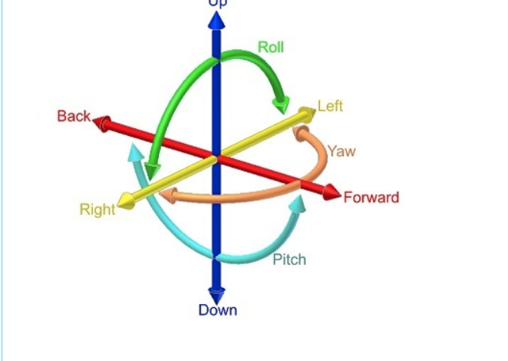
Rotation Translation
於攝影的過程中，如果相機為可以隨意移動，則可能有以下的移動方向：上下左右、前後、旋轉，這些動作對所拍攝影像的內容會有相對的影響：
相機的上下左右移動會造成影像內容的下上右左位移
相機的前後移動會造成影像內容的放大縮小
相機的 roll 旋轉會造成影像內容的逆方向旋轉
相機的 yaw, pitch 旋轉則會造成影像內容的 shearing
所以藉由推算出前後影像內容的相對關係，可以回推出相機在這兩張影像之間的移動與旋轉。
如上所述，相機的移動方向為 6 DoF (Degree of Freedom)，包括 3D Translation 以及 3D Rotation，如圖：

Slide 5
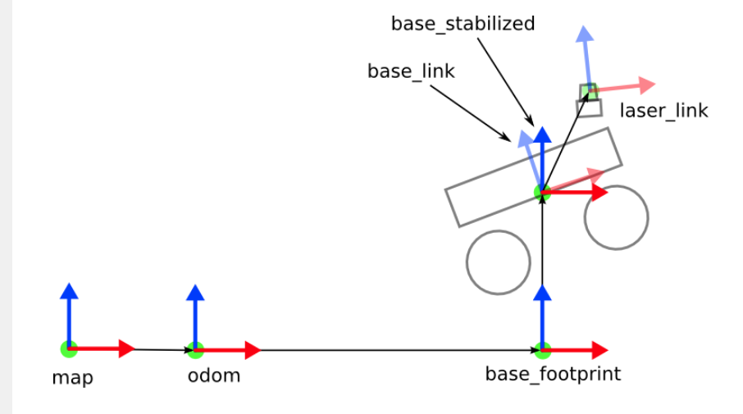
TF

